Slide 1

Idea/Approach Details Ministry/ Organization name: Ministry of Rural Development
Problem Statement : MK199 (Automatic Assessment of Pavement Condition based on Road Photographs)
Team Name : Segmentation Fault
Team Leader Name : Ashish Goswami
College Code : U-0795

Slide 2



Engineers and road Inspecting officers
Citizens
USERS

Slide 3
CONVENTIONAL METHOD
VARIATION IN RESULTS DUE TO HUMAN FACTOR
Standardization with PCI (Pavement Conditioned Index)
1
LACK OF TRANSPARENCY
Data acquisition and cloud deployment
2
SLACK IN WORK AND NEGLIGENCE
Geotagging
3
Notes:
Summarize by saying that:
all of these are mood changing chemicals that harm every young person who uses them.
Point out that the drugs may be legal or illegal.
Medically used drugs can also cause harm when a person uses medications which are not prescribed by the doctor for his/her use and have negative effects on the brain and body of the youngster.

Slide 4
CITIZENS
PRIORITY BASED BINS
1
COLOUR CODED ROADWAY MAPS
2
Notes:
Passing pieces of paper to each row.
Ask the students to write down questions about alcohol or drugs that they would like to be answered.
They need not write their names.
Just ask them to write the questions and get the last person seated in the row to place it in this box there.

Slide 5
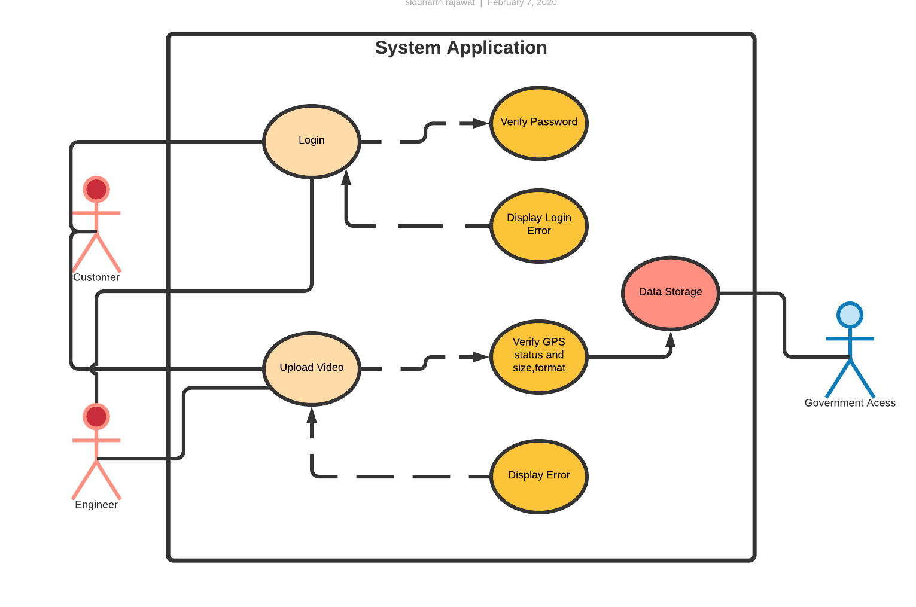
Use Case Diagram

Slide 6
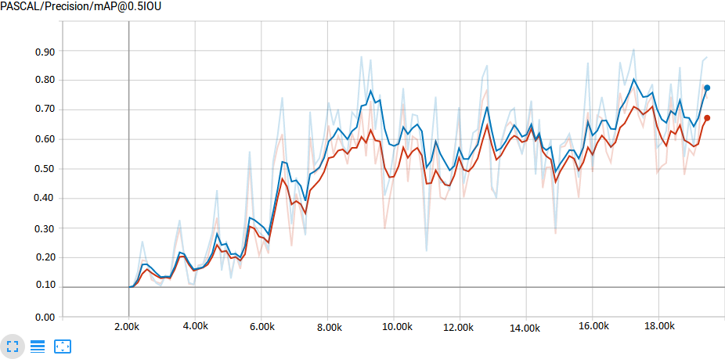

Slide 7

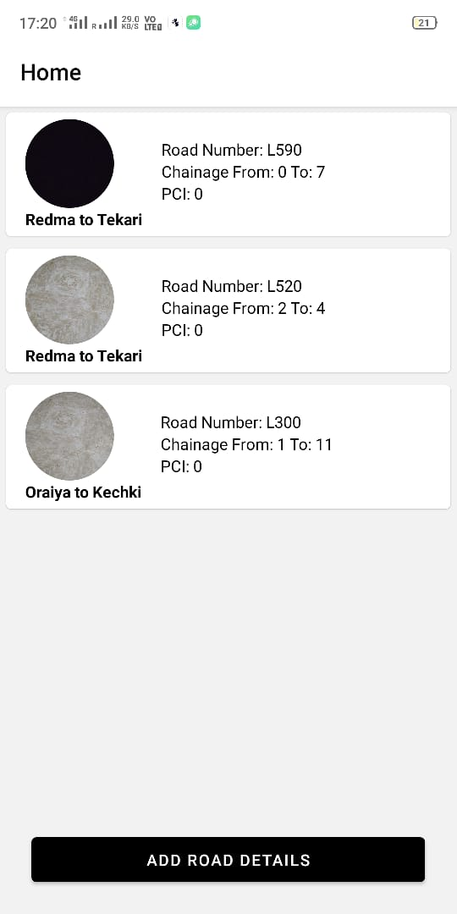
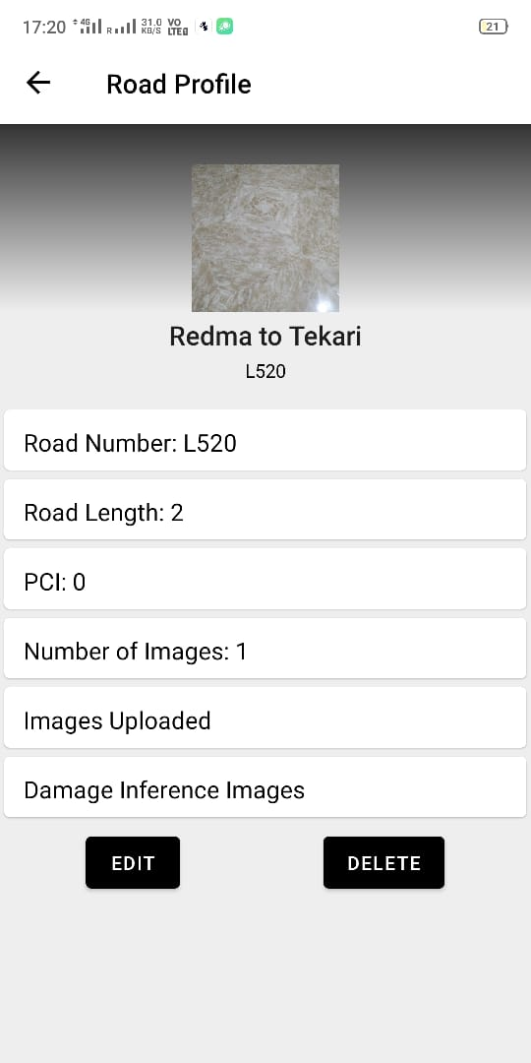
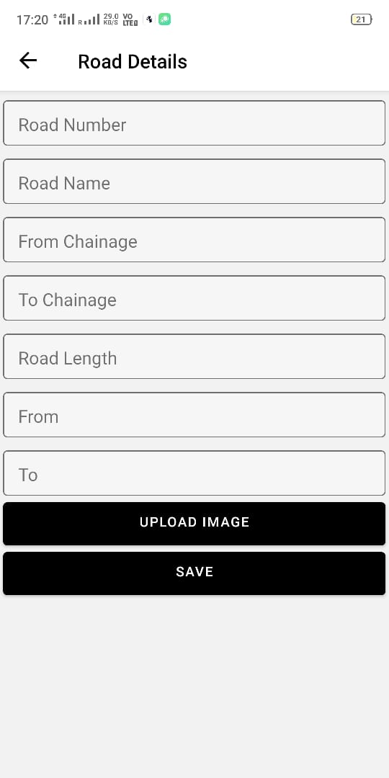
Images of Application

Slide 8
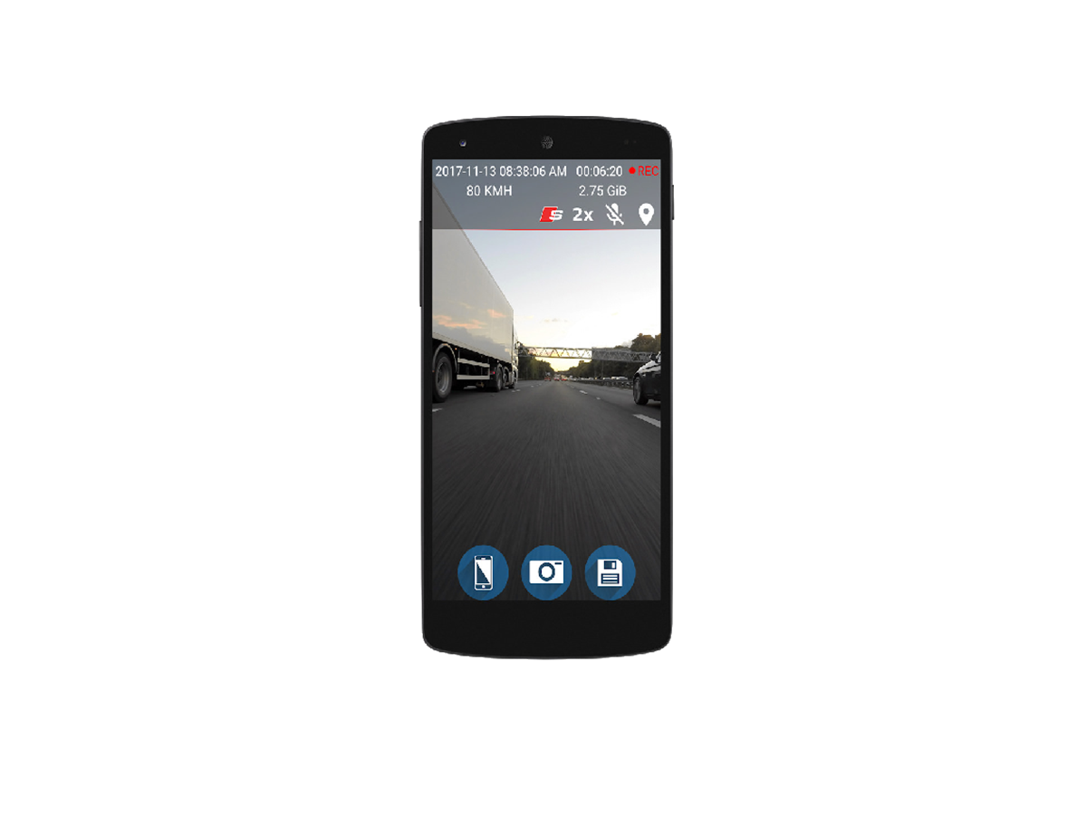
Idea/Approach Details
STEP 1: Capture the input image of the road segment
Capture the image of the desired section of the road through our application PATH (Pavement Assessment Tracking and Health)

Slide 9
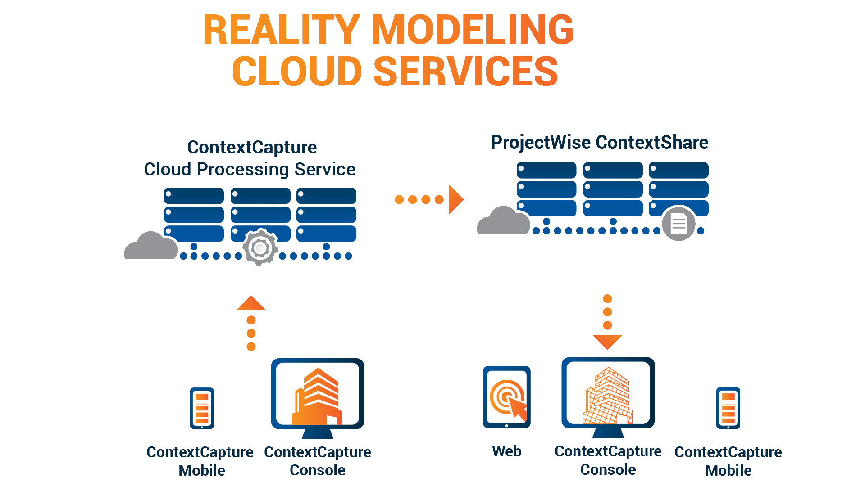
Idea/Approach Details
STEP 2: Prepossessing of the image
The captured image is sent to cloud server for pre-processing, which is then after used for assessing the image for the pavement condition

Slide 10
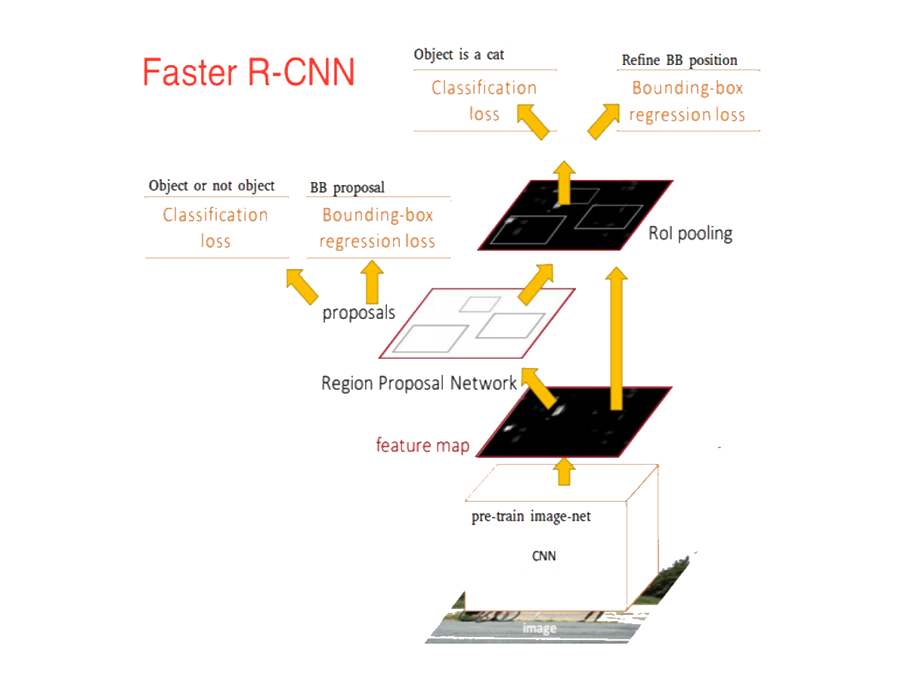
Idea/Approach Details
STEP 3: Feeding Images to Deep Learning
Model(Faster RCNN with Inception)
For assessment of the image for pavement condition We are using existing neural network frameworks i.e. Faster RCNN with Inception Backbone(CNN) to detect different categories of damages on pavements and then finally calculate PCI using the confidence level of the trained network.

Slide 11
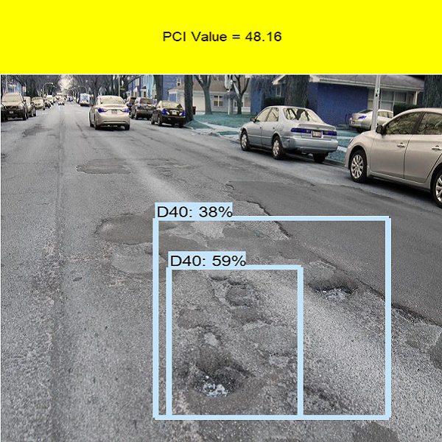
Idea/Approach Details
Step 4: Output images with detected damage types.
The images after being asses by the Deep Learning Model are outputted to out user application PATH, and the calculated PCI (Pavement Condition Index) is displayed.

Slide 12
Technology Stack Used
TensorFlow as back-end (1.14)
2) MERN stack for app development
3) Google API for geo-tagging
4) AWS for future cloud deployment.

